Slide 1


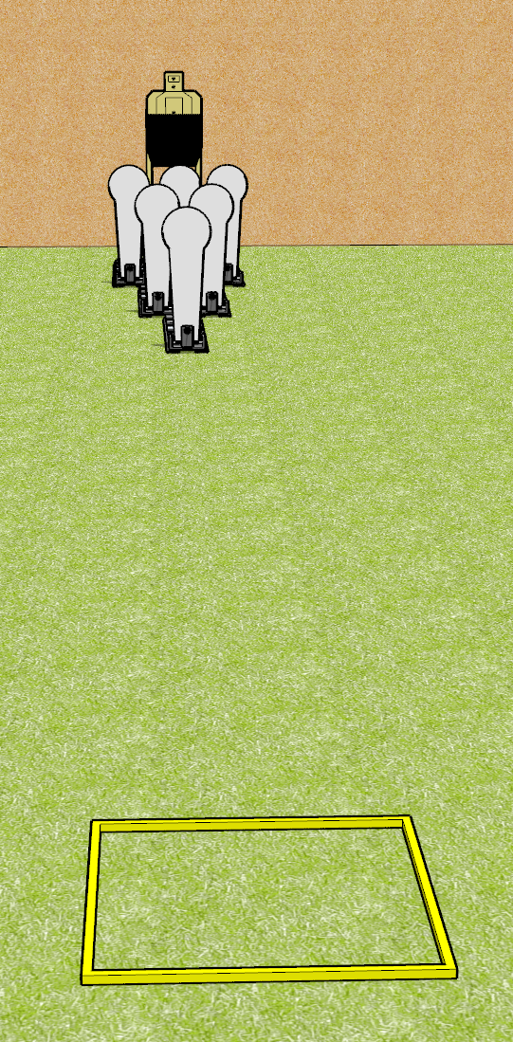
 | Dothan Gun Club – USPSA Match Bowling Pins Course Designer : Drew Coleman
Round Count 12 rounds 1 USPSA 6 colt poppers
Equipment List Shooting box 1 50%

Slide 2
Bowling Pins
Written Stage Briefing
Bowling Pins is a 12 round, 60 point, Comstock course of fire. There is 1 USPSA target and 6 colt poppers. The best 6 hits on paper will score, and steel must fall to score. The start signal is audible.
Handgun start position is in shooting box, wrists below belt. Handgun is loaded and holstered.
PCC start position is in shooting box, stock on belt. Loaded carbine is held with both hands, safety on.
On start signal, engage the paper or the steel, reload, and engage the remaining array. You must perform a reload when switching arrays.

